Slide 1
MULTIVARIATE TEMPORAL AUTOENCODER FOR PREDICTIVE RECONSTRUCTION OF DEEP SEQUENCES
Presentation Based on the paper and code by Jakob Aungiers
Gene Olafsen

Slide 2
acknowledgement
Paper by Jakob Aungiers of Altum Intelligence
https://altumintelligence.com/assets/multivariate-temporal-autoencoder-for-predictive-reconstruction-of-deep-sequences/MvTAe-ResearchPaper.pdf
https://github.com/jaungiers/MvTAe-Multivariate-Temporal-Autoencoder

Slide 3


Raindrop path on a window
Notes:
An example of the complexity of such a problem might be the seemingly random (stochastic) path of a raindrop down a window. By all respects this raindrop would appear to be taking a random walk down the windowpane, with the left and right movements seemingly unable to be determined or modelled. Consider however having the position of every water molecule, every glass molecule, their respective temperatures and their historical interactions graph with every other molecule available as data at every granular point in time. Given this information, it is reasonable to assume that there exists a model which can be created that is accurately able to specify where the raindrop will go next, and by extrapolating, where it will end up when it reaches the bottom of the windowpane.
The problem of course with the above example is that there currently exists no such method of capturing every observable aspect of a universe at a point in time. Hence for now the best we can do is look to create a model to approximate the hidden drivers of the raindrop given the best data we can gather.

Slide 4
Beyond the raindrop
"There are ample problems where a large amount of data can be gathered at very fine points in time and hence a model can be created to forecast the problem process."

Slide 5
Terms
Temporal Autoencoder
Deep Neural Network
Time Series
Multivariate Model
Feature Engineering
Signal Processing

Slide 6
Forecast the problem process
Small closed universe of potential drivers
Easier to forecast for greater sequential steps ahead
Great variety of influencing drivers
Exponential decay of accuracy through chaos and as such are only able to be modelled very short sequential steps ahead
The more influencing drivers of a system that can be worked into the model however, the more accurate the prediction process

Slide 7
Research fOCUS
Build a model which can process multivariate temporal sequences of data.
Leverage unsupervised learning. Specifically, multi-branch deep neural network approach utilizing autoencoding.
Referred to as: Multivariate Temporal Autoencoder (MvTAe)
The dataset demonstrated is created to be of a toy-dataset nature used to demonstrate the MvTAe model in simple yet fully functional circumstances.

Slide 8
Research Disclaimer
This research is not concerned with the other major challenge of real-world usage concerning observation, measurement and data processing.

Slide 9
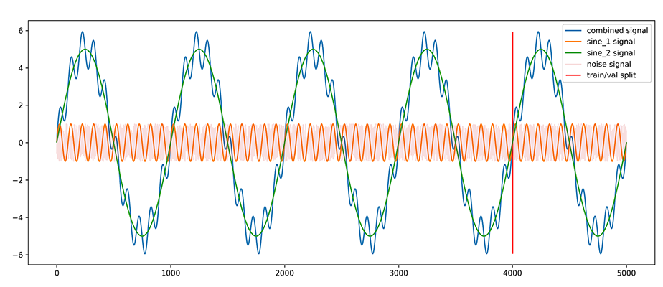
Dataset Image

Slide 10

Train and Test dataset
Sine_1(orange): a sinusoidal wave with a cycle period of 100 timesteps and an amplitude of 1.
This is a repeating pattern over time which will test the ability of the model to capture the sequential process of this pattern.
Sine_2 (green): a sinusoidal wave with a cycle period of 1000 timesteps and an amplitude of 5.
This creates a longer term cyclical sequence pattern which the model will not be able to see in full for each training example and hence it tests the models ability to capture cyclical trends.

Slide 11
Train and Test dataset
Noise (grey): a gaussian distribution of stochastic noise between -1 and +1.
Adds an extra dimension of redundant information to test the models ability to identify and disregard dimensions which do not contribute to the latent drivers of the data.
Combined_signal (blue): a sum of sine_1 and sine_2. This will be used as the Y target variable we are looking to predict and will NOT be included in the X training data that the autoencoder branch of MvTAe sees.
The red line is the Train/Validation split.

Slide 12
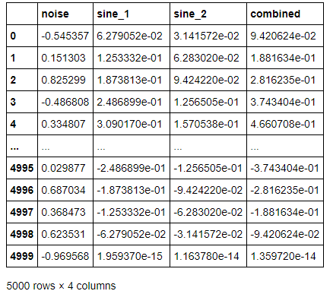
Training data sample

Slide 13
Data Preparation
The training dataset is split into sliding windows of length N with step S between each window.
This approach allows the training of our autoencoder branch to lookback across N temporal steps to determine relationship patterns within the temporal sequence.

Slide 14
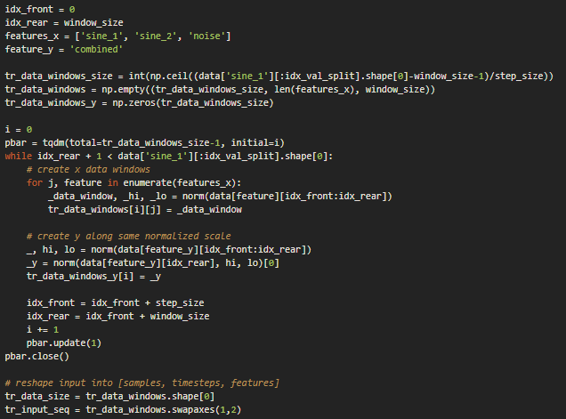
Window code
The code for creating the normalized sliding windows across dimensions and the accompanying target variable.

Slide 15
NOrmalize / De-normalize Data
Normalize
The process deals with temporal data windows along multiple dimensions.
It treats each window and each dimension within the window as independent (of other dimensions) in terms of normalization.
De-normalize
The de-normalization process is required to bring data back to the input scale.

Slide 16
MinMax normalization
With MinMax normalization we normalize data using the min (lo) and max (hi) values of the data window and hence these values created during the normalization process are required for the de-normalization process.

Slide 17


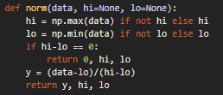

NOrmalize / De-normalize Data
Normalize
De-normalize

Slide 18
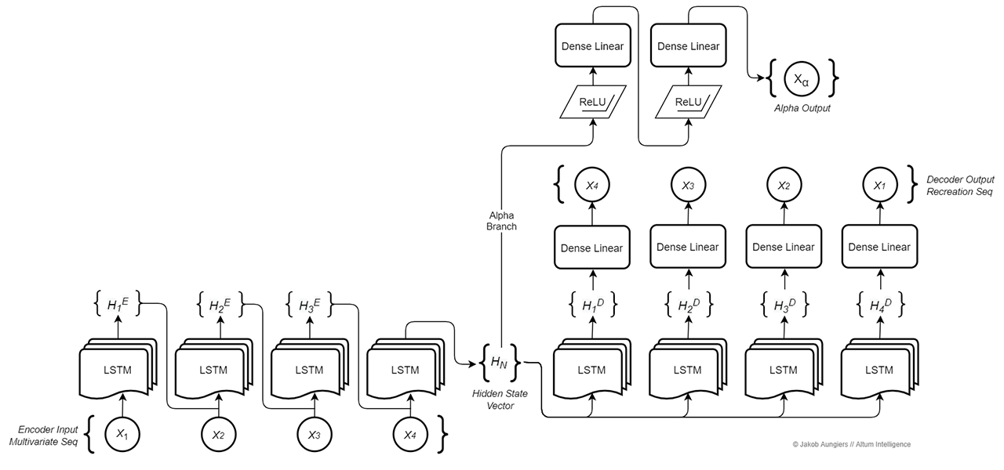
MULTIVARIATE TEMPORAL AUTOENCODER MODEL

Slide 19
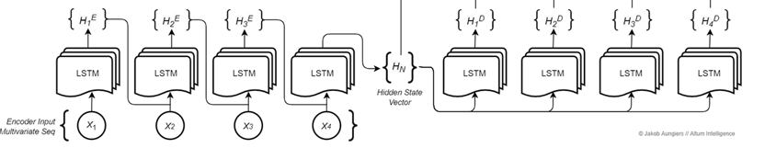
Encoder-decoder branch
The first branch of the MvTAe model is composed of two parts.
An encoder transforms the input sequence into the hidden state vector and a decoder which takes a hidden state vector and transforms it back into the original sequence, albeit in reverse. - Typically refered to an an autoencoder.

Slide 20
Let's Look into LSTM Autoencoders
Autoencoders use an Encoder-Decoder LSTM architecture.
Long short-term memory (LSTM) is an artificial recurrent neural network (RNN) architecture used in the field of deep learning. Unlike standard feedforward neural networks, LSTM has feedback connections
Autoencoders are a type of self-supervised learning model that can learn a compressed representation of input data.
Additionally, LSTM Autoencoders can learn a compressed representation of sequence data and have been used on video, text, audio, and time series data.

Slide 21
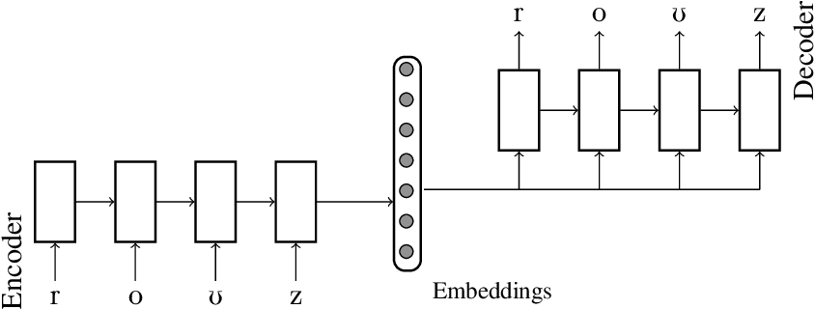
Encoder / Decoder
The design of the autoencoder model purposefully makes training challenging by restricting the architecture to a bottleneck at the midpoint of the model, from which the reconstruction of the input data is performed.

Slide 22
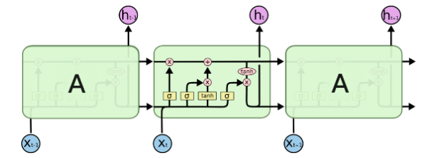
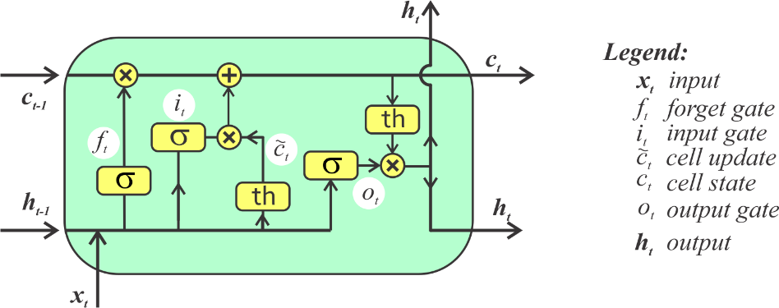
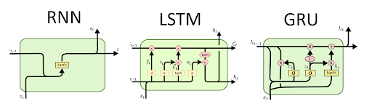
RNN's
LSTM

Slide 23

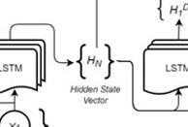
Hidden state vector and feature engineering
This hidden state vector, when the EncoderDecoder is properly trained, can be regarded as a high dimensional approximation of the drivers that make up the full dimensions of the entire input sequence.
In essence, this is the feature vector that traditional feature engineering aims to create and which is then used with the second branch of the model to predict future sequence steps, however the creation of this feature vector/hidden state vector is done in an unsupervised way by the decoder.

Slide 24
Decoder overview
The decoder structure is similar to the encoder in the sense that it is composed of the same layer of LSTM cells equal to the sequence length. The input to each of these cells is the hidden state vector created from the final context vector of the last encoder LSTM cell, copied across into each decoder cell.

Slide 25
Decoder 'Trick'
The decoder output – and what makes this process unsupervised – is the same input as to the encoder, hence the model acts in an autoencoder fashion mapping X → X.
Note: The decoder output targets are the reversed input of X (Xˆ) hence X → Xˆ. This is done as Sutskever et al. [5] found reversing the decoder targets significantly improves modelling accuracy, likely due to a higher influence of short-term dependencies within the sequences as opposed to longer term patterns.

Slide 26
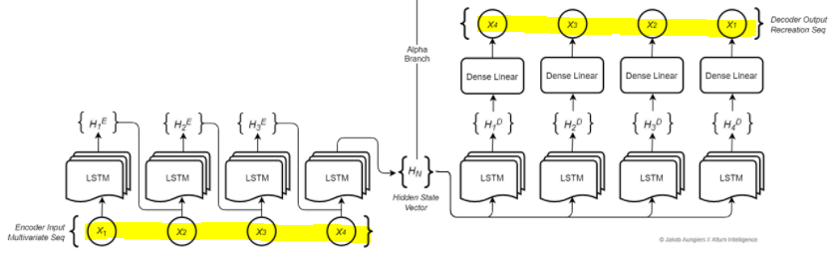
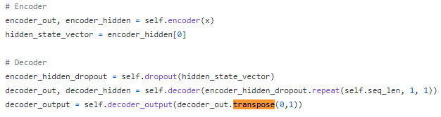
Decoder details

Slide 27
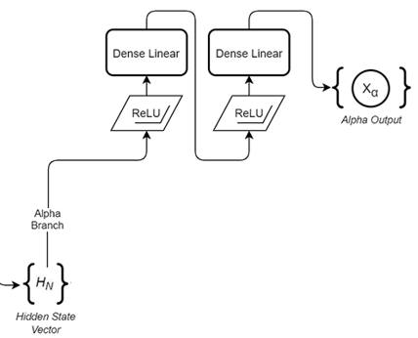
Predictive (ALPHA) branch
The second branch of the MvTAe model acts as a predictive branch - we call this the Alpha branch, as it generates a predictive alpha signal as its output. (The second branch of the model is expected to predict future sequence steps.)
Its input is the output of the encoder - the hidden state vector which, when trained sufficiently, represents the underlying context and drivers of the dataset, and hence can be used to train the predictive alpha branch for a forward looking prediction of the dataset.

Slide 28
Alpha branch code structure
The alpha branch has a fully connected structure.
Two fully connected hidden layers of neurons.
This fully connected layer enables the backpropagation training process to capture higher dimensionality linear functions within the hidden state vector data while allowing the LSTM decoder layer to focus on capturing the non-linear sequential functions within the data.
(continued next slide)

Slide 29
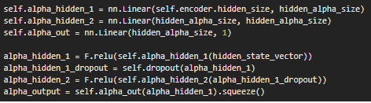
Alpha branch code structure
The alpha branch has a fully connected structure.
ReLU (Rectified Linear Units) activation functions are associated with these layers.
ReLU provide statibility in modelling non-linearity, which most complex sequential problems require (as shown by Zeiler et al.), and help alleviate the problem of vanishing/exploding gradients in the backpropagation process.

Slide 30
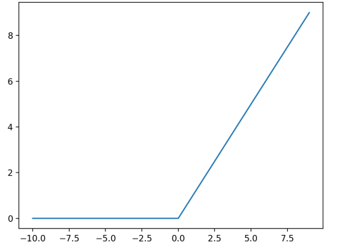
ReLU overview
Rectified Linear Unit is an activation function used in nearly all modern neural network architectures.
ReLU is defined as max(0, x).
This function that will output the input directly if it is positive, otherwise, it will output zero.
Similarly, the derivative of the rectified linear function is also easy to calculate.
The derivative of the activation function is required when updating the weights of a node as part of the backpropagation of error.
The derivative of the function is the slope. The slope for negative values is 0.0 and the slope for positive values is 1.0.

Slide 31
Activation FUnctions
An activation outputs a small value for small inputs, and a larger value if its inputs exceed a threshold. If the inputs are large enough, the activation function "fires", otherwise it does nothing. In other words, an activation function is like a gate that checks that an incoming value is greater than a critical number.
"Activation functions are useful because they add non-linearities into neural networks, allowing the neural networks to learn powerful operations. If the activation functions were to be removed from a feedforward neural network, the entire network could be re-factored to a simple linear operation or matrix transformation on its input, and it would no longer be capable of performing complex tasks such as image recognition." --DeepAI

Slide 32
RELU Advantages
Computationaly 'cheap' - no exponential calculations: tanh, sigmoid
Capable of outputting a true zero value. "This is called a sparse representation and is a desirable property in representational learning as it can accelerate learning and simplify the model." -- Page 507, Deep Learning, 2016.

Slide 33
Nn.linear
network = torch.nn.Linear(2,1);
Creates a network as show.
Weight and Bias values are initialized with random values.
i₁
w₁
o₁
w₂
i₂
b₁
bias

Slide 34
Pytorch nn.linear
nn.Linear(n,m) is a module that creates single layer feed forward network with n inputs and m output. Mathematically, this module is designed to calculate the linear equation Ax = b where x is input, b is output, A is weight. This is where the name 'Linear' came from.

Slide 35
Nn.Linear (2,2)
o₁
network = torch.nn.Linear(2,2);
w₁₁
i₁
w₂₁
b₁
bias
w₁₂
i₂
w₂₂
o₂
b₂
bias

Slide 36
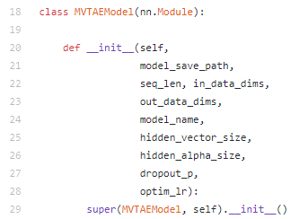
MVTAE Model Constructor
nn.Module (uppercase M) is a PyTorch specific concept. The code will subclass the nn.Module (used as a base-class and able to keep track of state).
At some point later, in the constructor there is a call to a method to build the model.

Slide 37
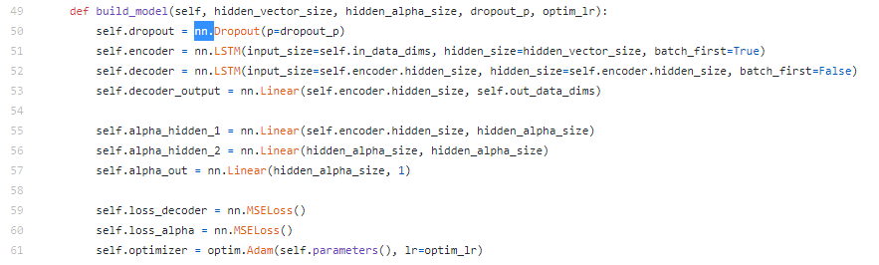
Build the mvtae model

Slide 38

Build a keras model

Slide 39
Keras vs Pytorch
Keras is a high-level API capable of running on top of TensorFlow, CNTK, Theano, or MXNet (or as tf.contrib within TensorFlow). Since its initial release in March 2015, it has gained favor for its ease of use and syntactic simplicity, facilitating fast development. It’s supported by Google.
PyTorch, released in October 2016, is a lower-level API focused on direct work with array expressions. It has gained immense interest in the last year, becoming a preferred solution for academic research, and applications of deep learning requiring optimizing custom expressions. It’s supported by Facebook.

Slide 40
Forward
The forward function computes output Tensors from input Tensors. The backward function receives the gradient of the output Tensors with respect to some scalar value, and computes the gradient of the input Tensors with respect to that same scalar value.
The forward function is user-defined when deriving from nn.Module.

Slide 41
autograd
The autograd package is central to all neural networks in PyTorch.
The autograd package provides automatic differentiation for all operations on Tensors. It is a define-by-run framework, which means that your backprop is defined by how your code is run, and that every single iteration can be different.
torch.Tensor is the central class of the package. If you set its attribute .requires_grad as True, it starts to track all operations on it. When you finish your computation you can call .backward() and have all the gradients computed automatically. The gradient for this tensor will be accumulated into .grad attribute.

Slide 42
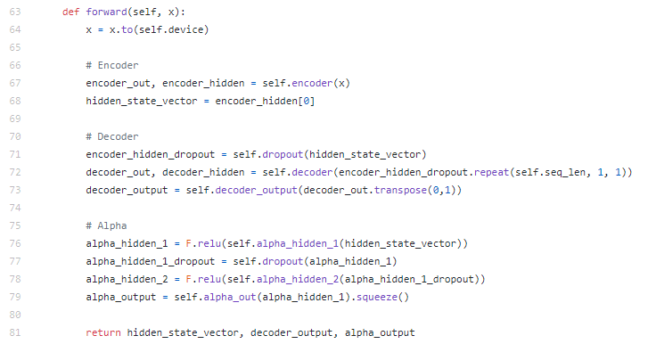
Forward method

Slide 43
Speed
Line 64 – Transfers a tensor from cpu to gpu (if available)
torch.cuda is used to set up and run CUDA operations. It keeps track of the currently selected GPU, and all CUDA tensors you allocate will by default be created on that device.

Slide 44
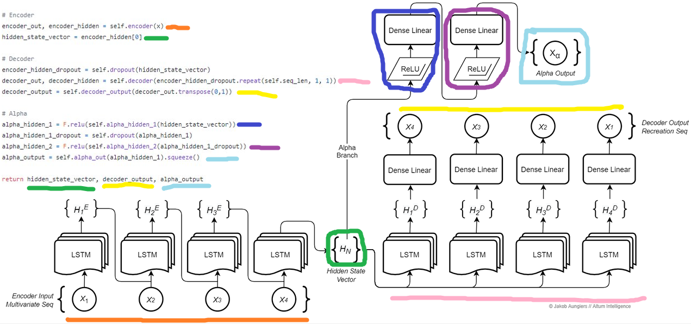

Slide 45
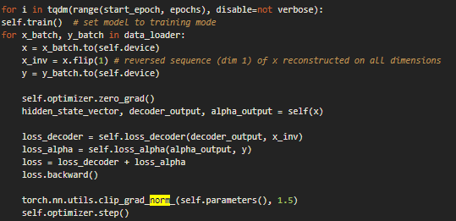
Model Fitting
The PyTorch code for the model fitting process.
The individual losses for each branch are summed up into a general loss which is then backpropagated.
Forward() method

Slide 46
tqdm
According to TQDM: "Instantly make your loops show a smart progress meter - just wrap any iterable with tqdm(iterable), and you're done!"
https://tqdm.github.io/
https://towardsdatascience.com/progress-bars-in-python-4b44e8a4c482

Slide 47
Zero out the gradients
When using PyTorch, there is a need to set the gradients to zero before starting to do backpropragation because PyTorch accumulates the gradients on subsequent backward passes.

Slide 48
Training
The EncoderDecoder branch and the Alpha branch are trained using the standard backpropagation algorithm with respect to a mean squared error (MSE) loss function.
The Adam optimizer function is employed due to the proven optimal convergence of regression problems.

Slide 49
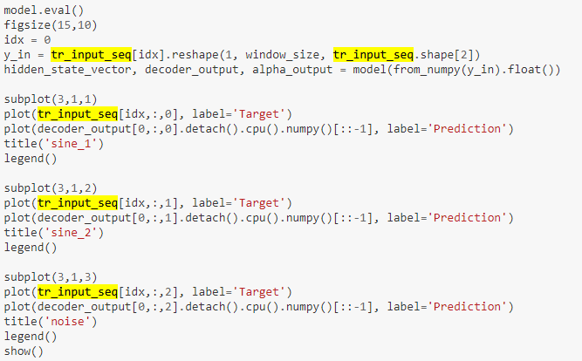
Decoder target recreation
model.eval() can be thought of as a switch for some specific layers/parts of the model that behave differently during training and inferencing time. E.g. Dropouts Layers, BatchNorm Layers etc. These are turned off during model evaluation.

Slide 50
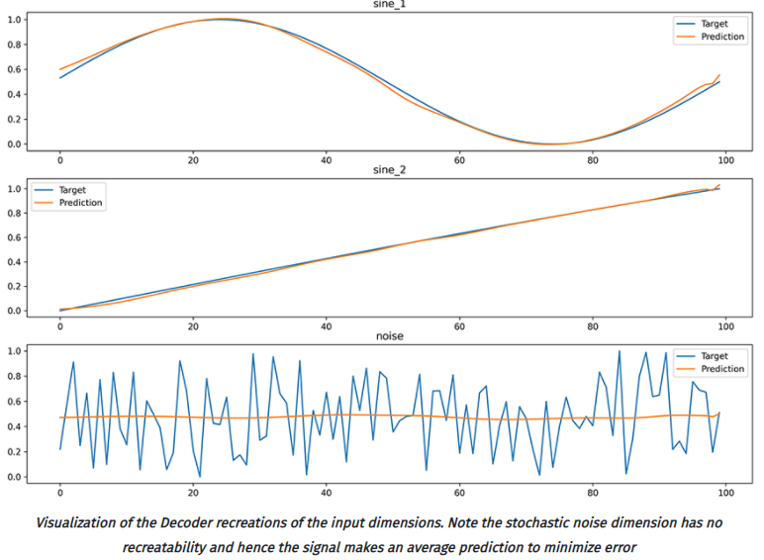
Decoder target output graph

Slide 51
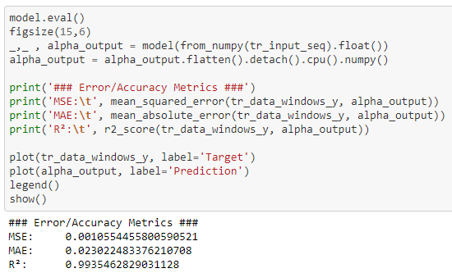
Alpha target branch prediction

Slide 52
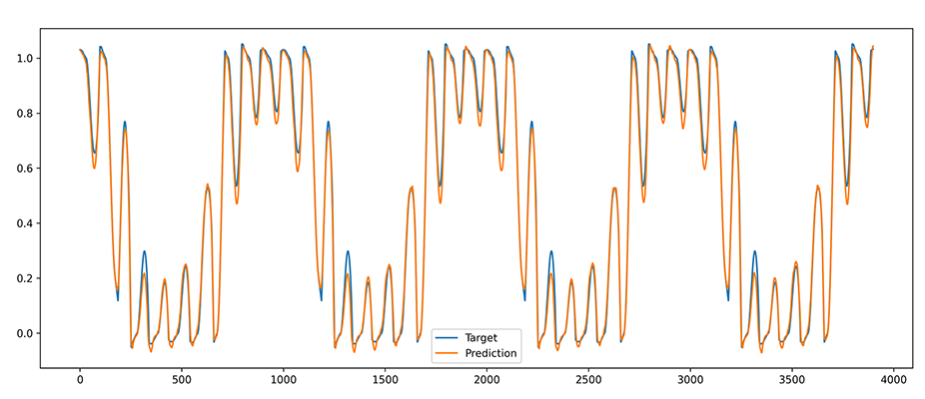
Alpha target branch prediction graph
Normalized Predictions vs Normalized Targets

Slide 53
Model instancing
Produce de-normalized predictions along the original reference data scale:
Create a data window on the fly
Store the hi, lo values for that normalized data window
Leverage the hi, lo values to de-normalize the final prediction output to plot against the original un-normalized data window.

Slide 54
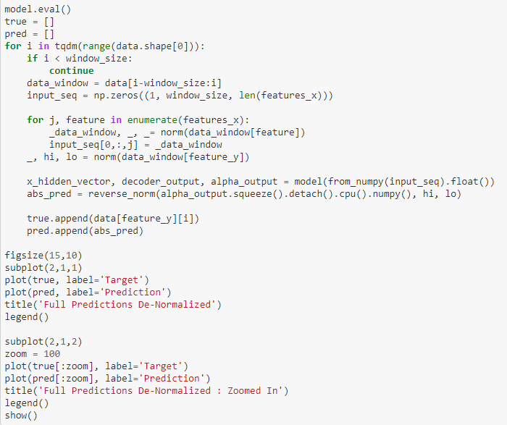
Prediction

Slide 55
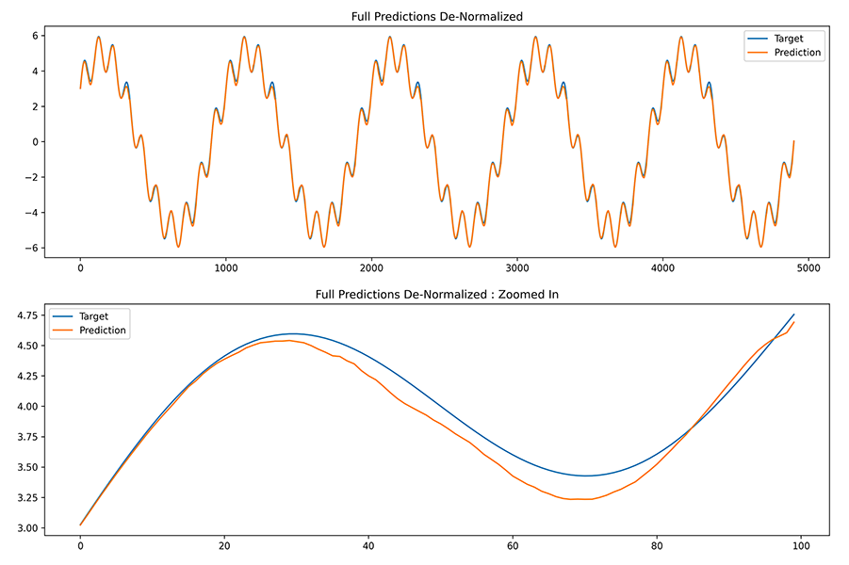
Prediction Graph

Slide 56
experiments
Result accuracy is measured using Mean Squared Error (MSE), Mean Absolute Error (MAE) and an R2 value to measure the correlation between the predictions and targets.
In each MSE and MAE we look to minimize the error in the first instance and maximize the R2 value in the second instance by tuning the three primary drivers of our model:
batch size
hidden vector size
data window size.
Many other hyperparameters such as learning rate, activation function values, and neural layer sizes can also be explored, however in these experiments we only show the three drivers mentioned above which were shown to have the greatest varying influence on accuracy and the other hyperparameters are left generally optimized.

Slide 57
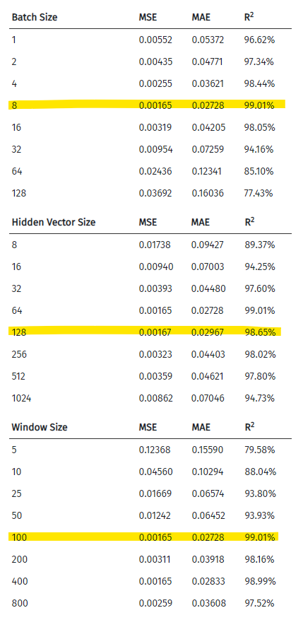
Results
The results of the experiments with show, through a short parameter search along three primary hyperparameters of batch size, hidden vector size and data window size for 100 epochs, that the most optimal of these parameters are: batch size = 8, hidden vector size = 128, window size = 100.
It is observed that there exist these optimal parameter states below which the full representation of the data cannot be captured and above which the representation is overly complex which leads to instability in accuracy.

Slide 58
Results – Hidden vector
Even with a very limited hidden vector size (8) a reasonably accurate data window representation can be created.
Despite the target signal being composed of 100 sequential steps of multiple dimensions, the representation of the full dimensionality of the data window can be compressed within a hidden state vector of size 8 and still retain 89.37% accuracy.

Slide 59
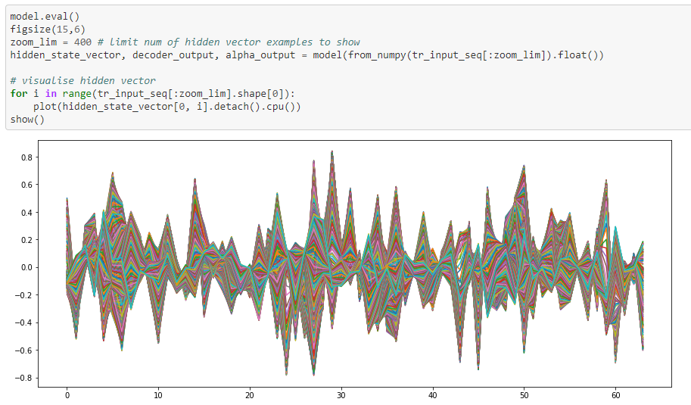
Hidden state vector visualization

Slide 60
Results - lstm
Due to the nature of LSTM cells the temporal memory is reasonably short and has a tendency to decay exponentially for longer term sequences. In this model this effect is dampened through the use of inverse target sequences in the EncoderDecoder branch, however this has the negative effect of diminishing long term dependencies if they exist.

Slide 61
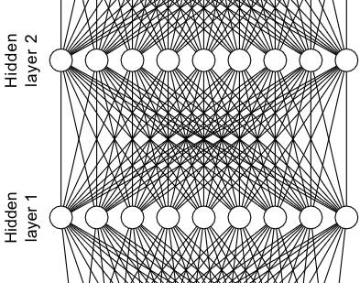
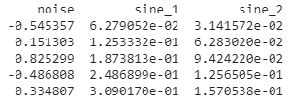
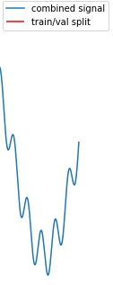
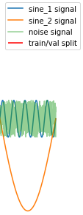
One Slide
Train a Dense Neural Network
Predict the next value.
Train on This
Prediction
Instance Using a 'Window' of Time Series Data
Calculate a Loss Function On This

